Slide 1

The effect of heating on food

Slide 2
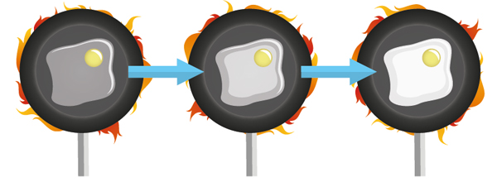
The effects of heat on food
The effect of heating on food
What happens to proteins?
During cooking proteins denature and coagulate.
The video clip below shows the effect that heat has on protein.
https://www.youtube.com/watch?v=PxAP86zIJdc

Slide 3
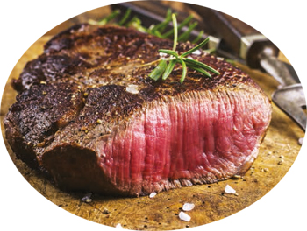
The effects of heat on food
The effect of heating on food
What happens to proteins?
When proteins are heated with
a dry heat a Maillard reaction occurs.
This link will tell you about the Maillard reaction.
https://www.youtube.com/watch?v=SLAz3oiMi8Q

Slide 4
The effects of heat on food
The effect of heating on food
What happens to fats?
Fats contain a small amount of water so they soften, then liquefy when heated.
This property is called plasticity, and it reflects the fact that fat cannot evaporate.
The chemical make-up of fat determines its hardness at room temperature and this information is needed when deciding on the type of fat to use for a recipe.

Slide 5
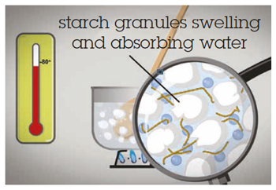
The effects of heat on food
The effect of heating on food
What happens to carbohydrates?
The change that starches undergo
during cooking is called
gelatinisation.
The video below shows the effect of heat on starch.
https://www.youtube.com/watch?v=PxAP86zIJdc

Slide 6
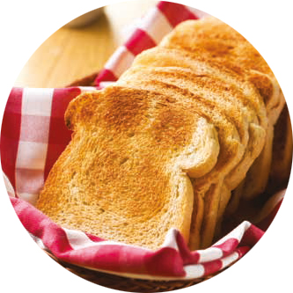
The effects of heat on food
The effect of heating on food
What happens to carbohydrates?
If starch is heated by a dry heat, dextrins are
produced which are brown in colour.
This process is called dextrinisation.
It is responsible for the browning of toast.
Caramelisation happens when sugar is cooked; the food gradually turns brown and changes flavour. The video clip below shows the caramelisation process.
https://www.youtube.com/watch?v=sghF3WCGpBs

Slide 7
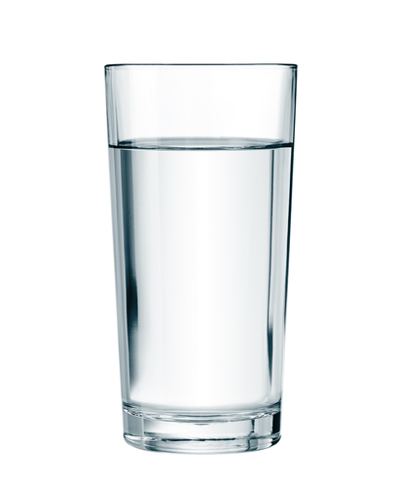
The effects of heat on food
The effect of heating on food
What happens to water?
All foods contain water. When they
are cooked and the temperature of
the food increases, the water molecules
move faster and faster until the water
turns to gas (steam) and evaporates.
The evaporation of water causes the volume of food to be reduced and for the food to become dry.

Slide 8
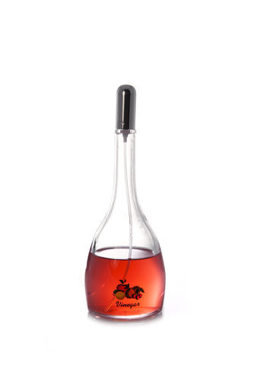
The effects of pH on food
The effect of heating on food
Some foods are acid and some are alkali. Those foods that are neither acid or alkali are neutral and have a pH value of 7.
These foods have a number of uses in food preparation:
Vinegar is used to preserve vegetables in pickling and chutney making.
Lemon juice, tomatoes and vinegar will help soften connective tissues in meat and cornflour based sauces.
Adding vinegar or lemon juice to a meringue mixture, affects the protein and gives it a marshmallowy texture.

Slide 9
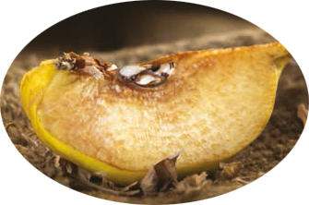
The effects of oxygen on food
The effect of heating on food
Fruit and vegetables
When some fruit and vegetables are
sliced (e.g. apples, potatoes and
parsnips) they go brown.
The video clip below looks at the causes of enzymic browning and ways that it can be prevented.
https://www.youtube.com/watch?v=rEvQD8V9Des

Slide 10
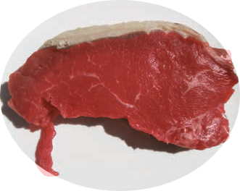
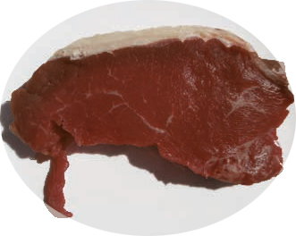
The effects of oxygen on food
The effect of heating on food
Meat, poultry and fish
Raw meat contains myglobin which
gives the flesh a bright red colour.
When fresh meat has been stored for
several days and has come into contact
with oxygen, the chemical changes in
the myglobin cause it to become brown.

Slide 11
The effects of enzymes on food
The effect of heating on food
Enzymes control the working properties of cells. Heat stops enzyme activity.
Enzyme action works on under-ripe fruit to continue the ripening process once it has been picked.
Changes caused by enzyme action can be controlled by food technologists to enable fruits and vegetables to be available out of season.

Slide 12
The effects of enzymes on food
The effect of heating on food
Oxygen and food enzymes often work together to affect foods.
Fruit will soften and brown.
Raw meat will go brown.
Raw fish will become soft.
Enzymes soften meat muscle fibres and improve flavour during the hanging process.
Enzymes in the human digestive system enable food to be digested and allow nutrients to be absorbed.

Slide 13
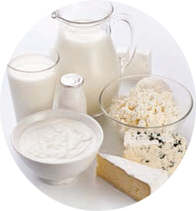
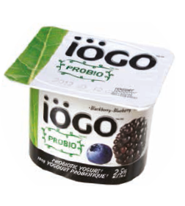
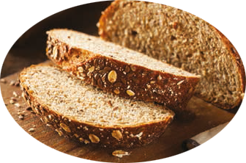
The effects of microorganisms on food
The effect of heating on food
Yeasts are used in bread manufacture, the fermentation of cereals in beer production and fruit to make wine.
Probiotic microorganisms are used in yogurt to aid digestion.
Lactic acid bacteria is fermented in milk to produce yogurt and cheese.

Slide 14
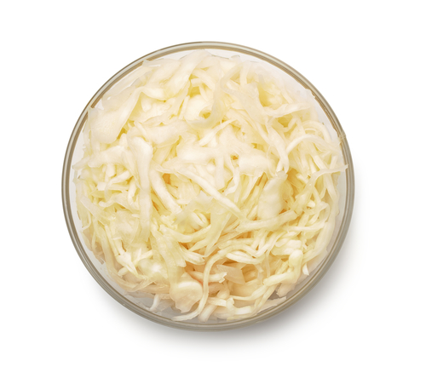
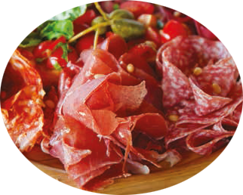
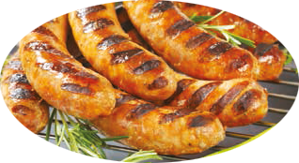
The effects of microorganisms on food
The effect of heating on food
Lactic acid bacteria is used to make salami, pepperoni, chorizo and dried ham.
Moulds are used to ripen the surface of sausages, preserving the product and controlling the flavour development.
Sauerkraut is made from fermented cabbage and soy sauce from fermented soya beans.

Slide 15
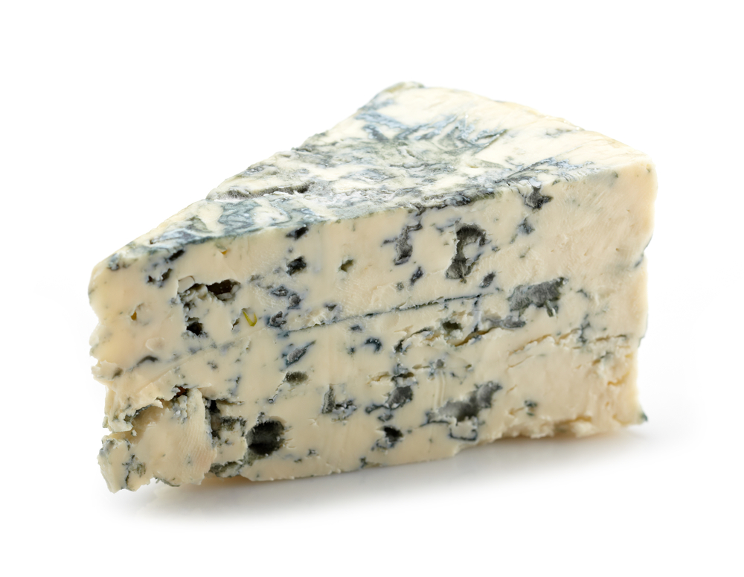
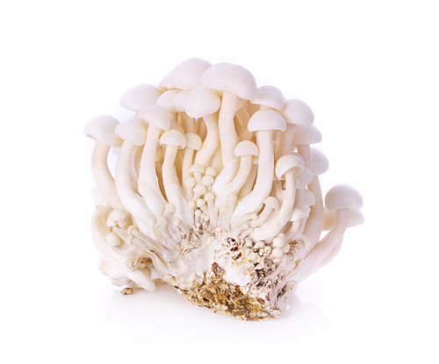
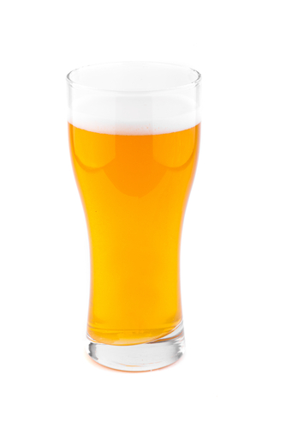
The effects of microorganisms on food
The effect of heating on food
Lactic acid and yeasts can be used to ferment soft drinks such as ginger beer.
Mushrooms are the edible fruiting bodies of fungi.
Blue and Roquefort cheese use moulds to create creamy textures, sharp, tangy flavours and some protection from more harmful bacteria.

