Slide 1
Food science: gluten
Learning objective
Know what a raising agent is, the role of a raising agent in several applications and how a raising agent works
Success Criteria
Use your knowledge gained today to form an hypothesis for our future experiment

Slide 2
Bell Work
Write the title ‘’cold task’’ and underline
In your groups add warm water to one of the pots and cold to the other
Describe your observations

Slide 3
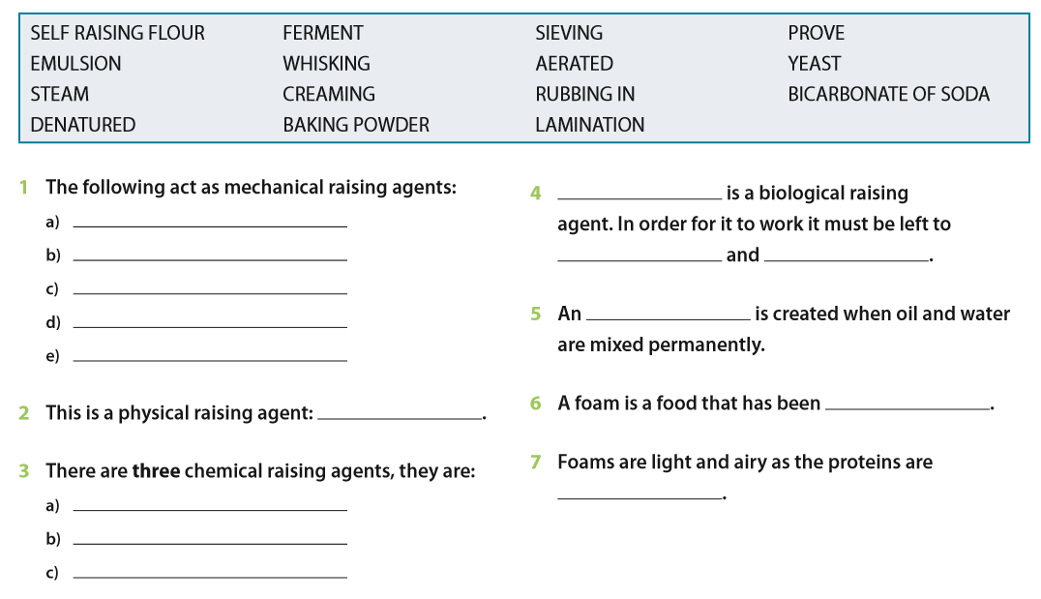

Slide 4
Task 1
Using the online text book research the key aspects of each type of raising agent.(P77-78)
Mechanical
5 types and examples, complete the experiment
Physical
Create a diagram or list of processes on how a this raising agent work
Chemical
3 types, complete the experiment
Biological
Definition, equation, application in bread.

